Slide 1
SWOT Analysis (1 of 2)
Environmental scanning
Monitoring of an organization’s internal and external environments to detect early signs of opportunities and threats that may influence the firm’s plans
SWOT, process for scanning
Internal Strengths
Internal Weaknesses
External Opportunities
External Threats
Notes:
A SWOT analysis should provide you with a realistic understanding of your organization in relation to its internal and external environments so you can better formulate strategy in pursuit of its mission.
A SWOT grid is shown on the next slide.

Slide 2
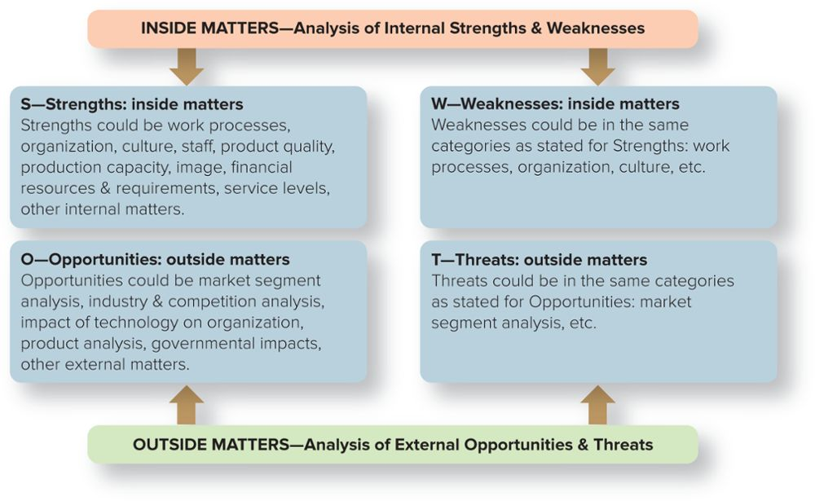
SWOT Analysis (2 of 2)
Figure 6.2
Jump to Appendix 2 for description
Notes:
The SWOT analysis is divided into two parts: inside matters and outside matters—that is, an analysis of internal strengths and weaknesses and an analysis of external opportunities and threats.
Organizational strengths: skills and capabilities that give the organization special competencies and competitive advantages in executing strategies in pursuit of its mission
Organizational weaknesses: drawbacks that hinder an organization in executing strategies in pursuit of its mission
Organizational opportunities: environmental factors that the organization may exploit for competitive advantage
Organizational threats: environmental factors that hinder an organization’s achieving a competitive advantage

Slide 3
Example: SWOT Characteristics of a College Campus
Table 6.2
S—STRENGTHS (INTERNAL STRENGTHS) | W—WEAKNESSES (INTERNAL WEAKNESSES)
Faculty teaching and research abilities High-ability students Loyal alumni Strong interdisciplinary programs | Limited programs in business High teaching loads Insufficient racial diversity Lack of high-technology infrastructure
O—OPPORTUNITIES (EXTERNAL OPPORTUNITIES) | T—THREATS (EXTERNAL THREATS)
Growth in many local skilled jobs Many firms give equipment to college Local minority population increasing High school students take college classes | Depressed state and national economy High school enrollments in decline Increased competition from other colleges Funding from all sources at risk
Notes:
Here is an example of a SWOT that could be performed on a typical college campus.

